Slide 1
Class and Objects

Slide 2
Evaluation of Object Oriented Programming
The Object-oriented programming was first introduced at MIT in the 1950’s, which gained speed in the 1970’s.
In the 1980’s Bjarne Strousstrup integrated OOP into C Language and called it C++. It was the first object-oriented language that was widely used and was successful commercially.
In 1990, James Gosling of Sun Micro Systems developed a simple version of C++ called Java and it was widely used to develop applications on internet, as Internet became a rage in those times.

Slide 3
What is Object Oriented Programming?
Object-oriented programming (OOP) is a programming paradigm based on the concept of objects, which may contain data, in the form of fields, often known as attributes and code, in the form of procedures, often known as methods.

Slide 4
What is Object Oriented Programming?
Any Object-oriented programming language(OOP) should support the following concepts:
Encapsulation - Ability to model abstract real world objects (characteristics(attributes) and behavior (methods)) and hide unnecessary information.
Inheritance - Ability to create sub-classes from existing classes.
Polymorphism - Ability of an object to adapt the code to the type of the data it is processing.

Slide 5
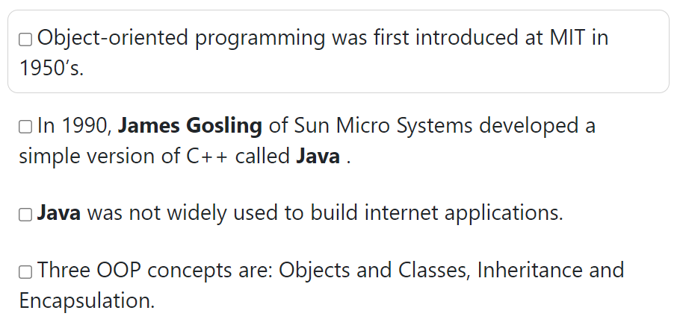
Find the true options?

Slide 6
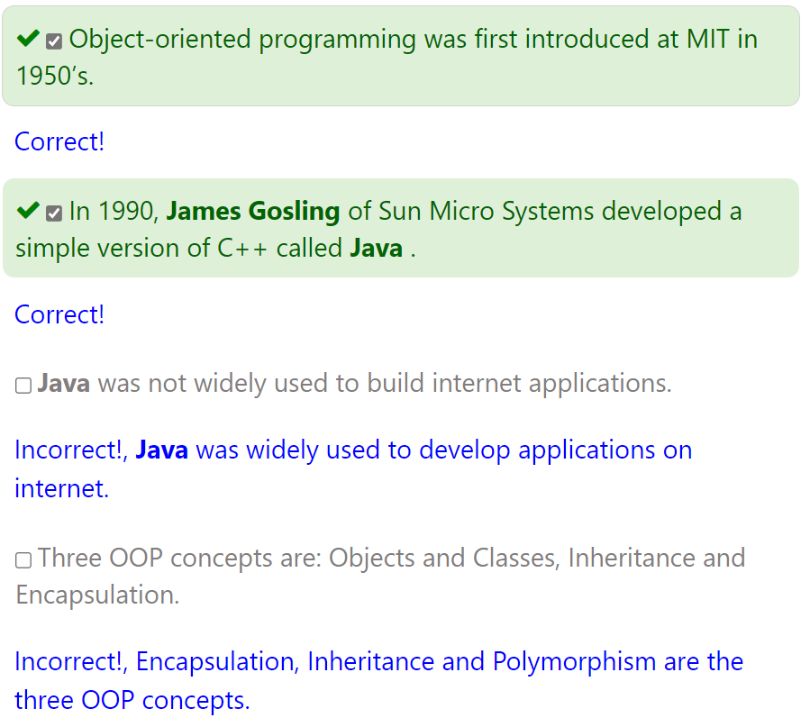
Find the true options?

Slide 7
What is OOP Paradigm?
A programming paradigm defines the methodology of designing and implementing programs using the key features and other building blocks of a programming language and gives you an idea of how problems are generally analysed and solved in a particular programming language.
Some other programming paradigms
Procedural Programming
Object Based Programming
Object Oriented Programming

Slide 8
What is Procedural Programming?
Procedural programming (also known as imperative programming) is a programming paradigm that uses a linear or top-down approach. It is based on the concept of the procedure call.
In procedural programming, a program consists of data and procedures that operate on the data. The two are treated as separate entities. It lays more emphasis on procedure than on data.
Procedures, also known as routines, subroutines, or functions, simply contain a series of computational steps to be carried out. C programming language uses procedural programming style.

Slide 9
Then Why OOPs?
Pros
For smaller programs the code is usually small, more readable and result oriented.
They are usually very efficient since they are written for a very specific purpose.
Cons
Since programs are function biased they do not relate to a real life object.
When large amount of code is written inside functions, it becomes very difficult to maintain or make modifications.
Changing the way data is stored may require large amount of changes in code, making it difficult to maintain large systems.

Slide 10
Object based Paradigm
Object based programming is a programming paradigm that implements some features of Object-oriented programming but not all.
In Object based programming, data and its associated meaningful functions are enclosed in one single entity called Class.
Classes enforce information hiding and abstraction thereby separating the implementation details.
In Object based programming, whenever there is any change in the definition of type, user interface remains unaffected generally.
Object based programming can be treated as a subset of Object-oriented programming as it implements some of the features implemented by Object-oriented programming like information hiding, abstraction, classes, function overloading, etc.

Slide 11
Object based Paradigm
Object based programming paradigm does not implement Inheritance and Polymorphism. Java Script, Visual Basic are Object based programming languages.
The advantages of Object based programming are:
  It overcomes most of the shortcomings of Procedural programming
  It localizes changes and hides implementation details from user
  It supports user-defined types
  Implements information hiding and abstraction
However, Object based programming suffers from one major limitation and that is its inability to represent real world relationships that exist among objects.
Object-oriented programming paradigm is a superset of Object based programming. It offers all the features of Object based programming and overcomes its limitation by implementing Inheritance.

Slide 12
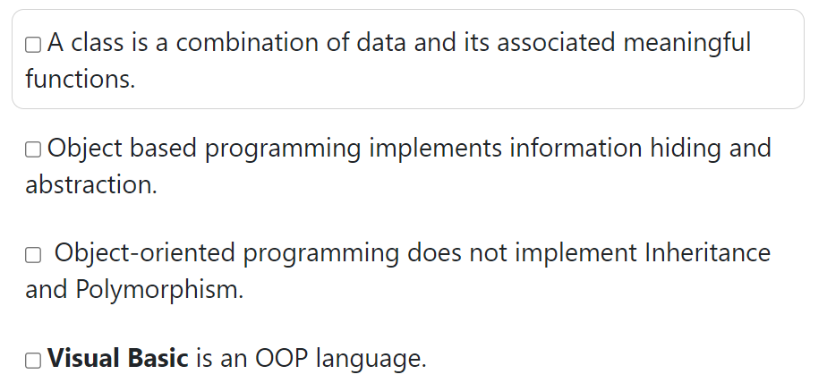
Find the Correct Options

Slide 13
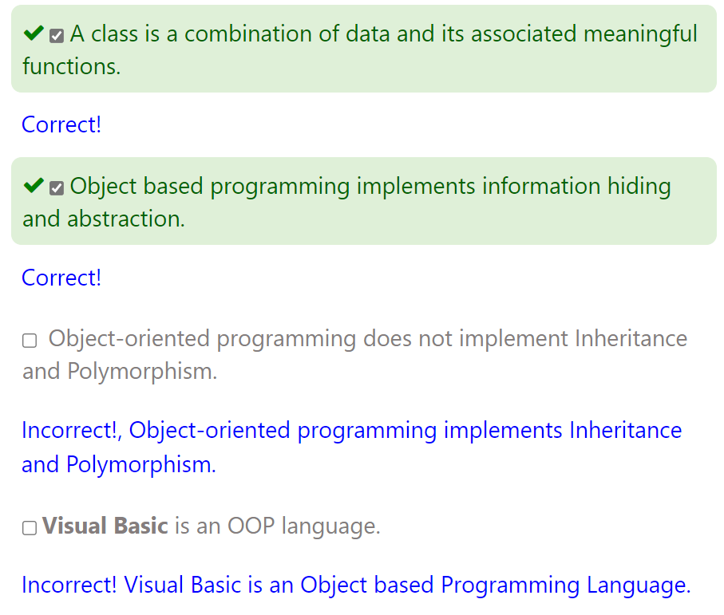
Find the Correct Options

Slide 14
What is a class?
A class is a blueprint or design that defines the variables and the methods common to all objects of a certain kind.
  The data stored in its variables are known as attributes / fields.
  The code that can access this data to give the necessary output are called methods / functions .

Slide 15
What is instance or object?
Definition: An object is a software bundle of variables and related methods.
We can look around and find many examples of real-world objects such as: our mobile phone, our car, our ceiling fan, our clock,..etc. All these real-world objects share two characteristics: state and behaviour.
For example, mobiles have states (model name, colour, battery saver, switched on/off) and behaviour (call ringing, playing music, recording videos).

Slide 16
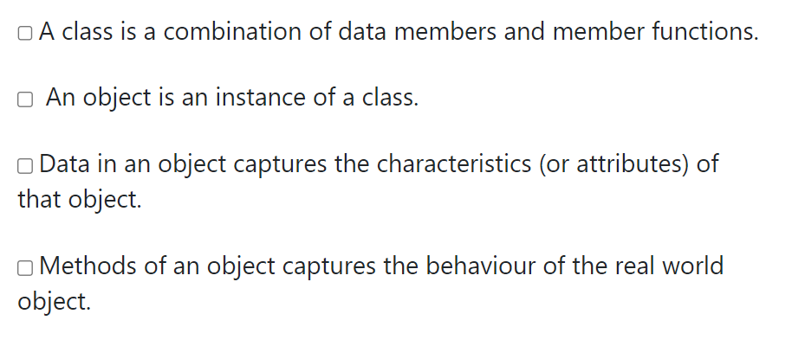
Find the Correct Options

Slide 17
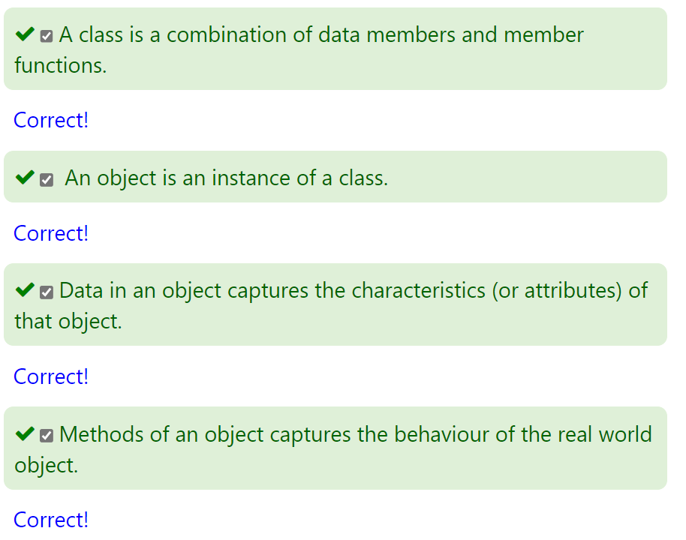
Find the Correct Options

Slide 18
What is Encapsulation?
Encapsulation is one of the fundamental concepts in Object-oriented programming.
It describes the idea of bundling data and methods that work on the data within one unit restricting access to some of the object’s components (variables and methods)
A class is an example of encapsulation as it binds together data and its associated functions under one unit.
Advantages:
It can prevent the accidental modification or misuse of data by an outside entity.
It allows programmers better control of how data flows in their programs.

Slide 19
What is Abstraction?
Abstraction is used as a technique to identify all the essential characteristics and behaviour of an object and to omit those aspects that are unimportant.
Information Hiding is hiding all the unnecessary information (like implementation details etc.) from outside entities.
A class groups its members into three sections as private, protected and public.
The private and protected members remain hidden from outside world i.e., a class enforces data hiding. The outside world is given only the essential and necessary information through public members, rest of the things remain hidden which is nothing but abstraction.

Slide 20
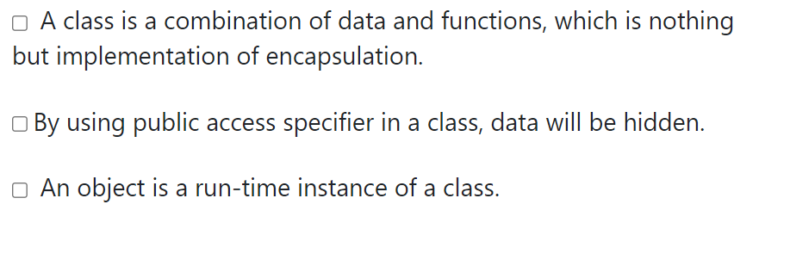
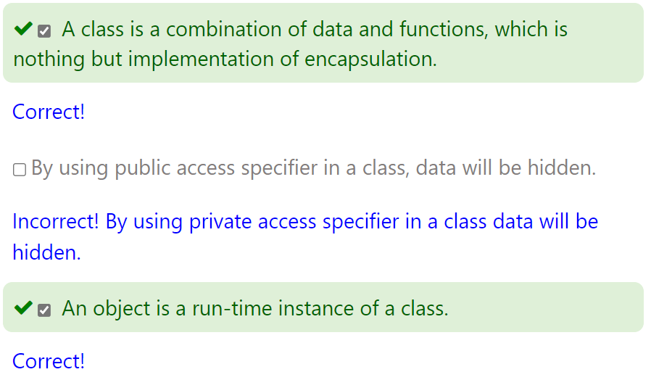
Find the Correct Options

Slide 21

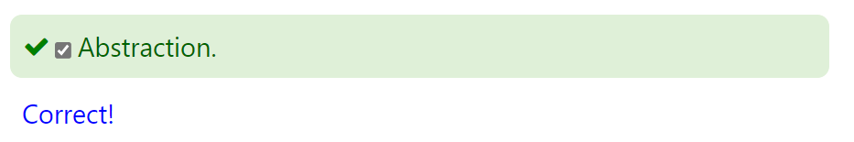
Which concepts hides data?

Slide 22
How to write a class?
A class can be defined using the class keyword. By convention, capitalised names refer to classes in Python.
A class consists of 4 key members:
Constructor: The constructor must have a special name __init__() and a special parameter called self. In Python, the constructor is invoked automatically whenever a new object of a class is instantiated.
Class variable / Class attribute: A class variable contains information that is shared by all objects of the class.
Instance variable / Instance attribute: An attribute that is created per instance/object.
Method(s): A function that can access any of these variables.

Slide 23
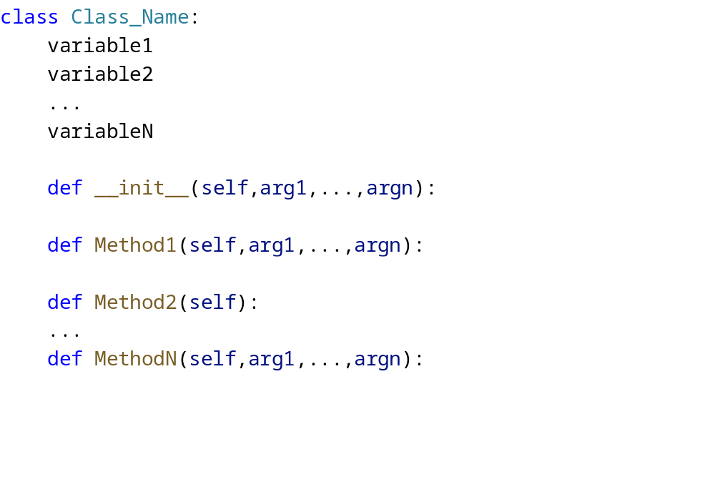
How to write a class?

Slide 24
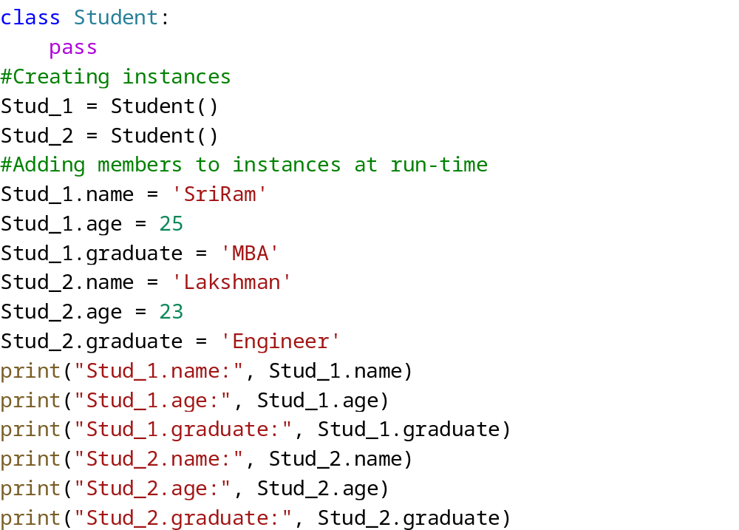
How to write a class?

Slide 25

How to write a class?
A class can also be defined without any members. The following is a class with a doc string.
Note: The pass statement does nothing. It can be used when a statement is required syntactically but the program requires no action. It is ignored by the Python interpreter.

Slide 26
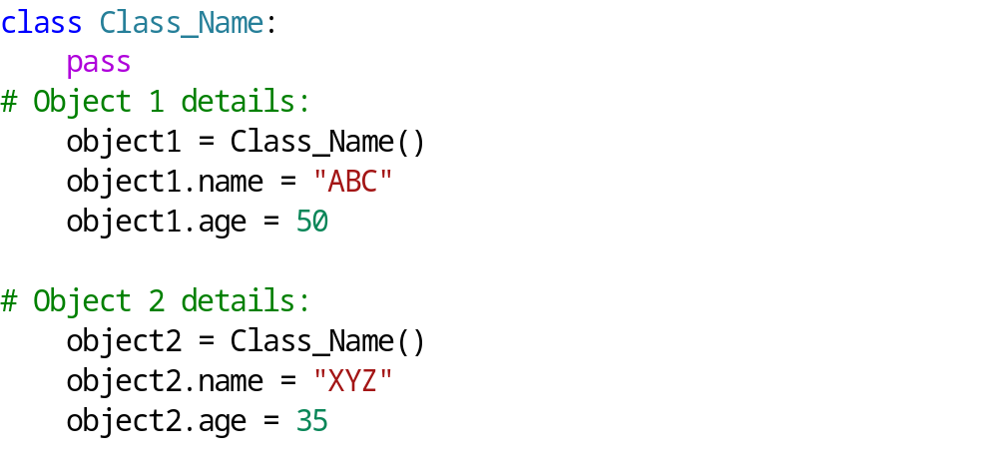
Adding attributes of an empty class later to the object
Python allows us to set the attributes of an object of an empty class. We can also set different attributes for different objects and print their details as shown in the sample code below:

Slide 27
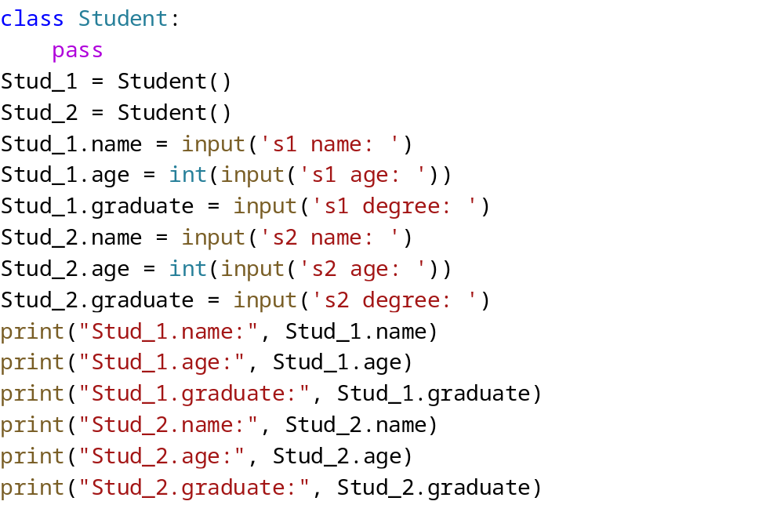
Solution

Slide 28
Problem
Write a program that defines a class Employee and add a pass keyword
Create an instance Emp_1 of class Employee
Take string input from user and store it in a variable name
Set Employee name to the user input
Set Employee age to 25
Set Employee salary to 25000
Print name # print( 'Emp_1.name: ' , Emp_1.name)
Print salary # print( 'Emp_1.salary:' , Emp_1.salary)

Slide 29
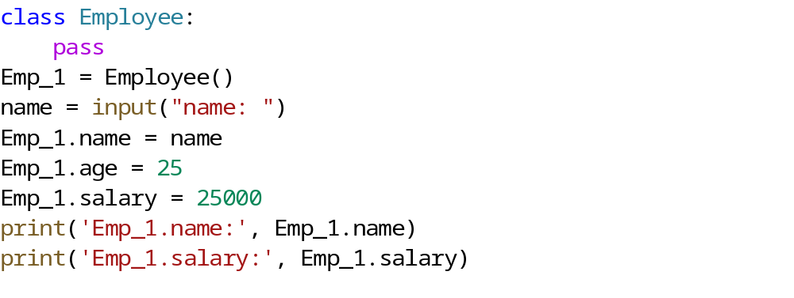
Solution

Slide 30
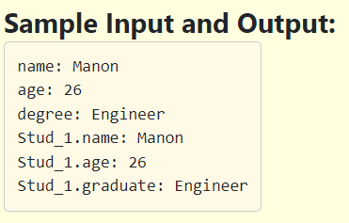
Problem
Create a class Student. which contains the details of the student like name, age, graduation, take these inputs from the user and print the result as shown in the example.

Slide 31
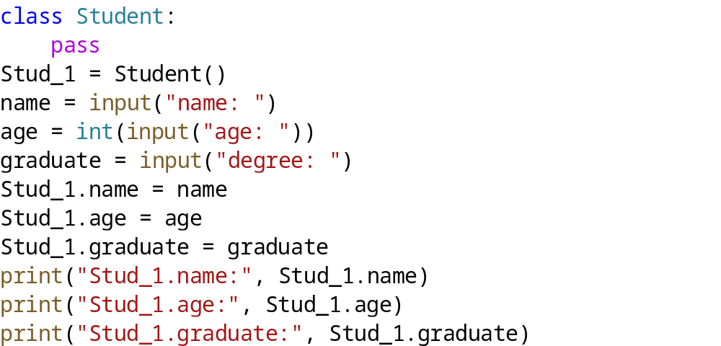
Solution

Slide 32
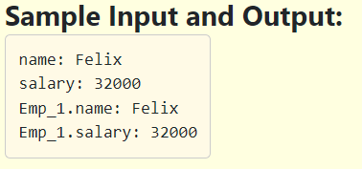
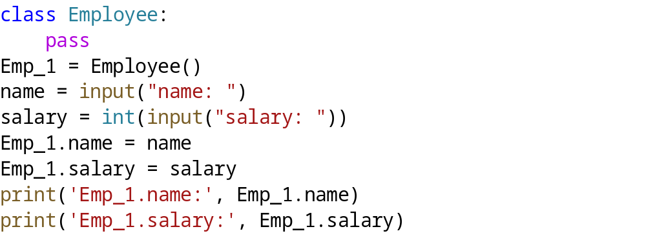
Problem with solution
Create a class Employee, which contains the details of an employee like name and salary. Take name and salary as inputs from the console, print the result as shown in the example.

Slide 33
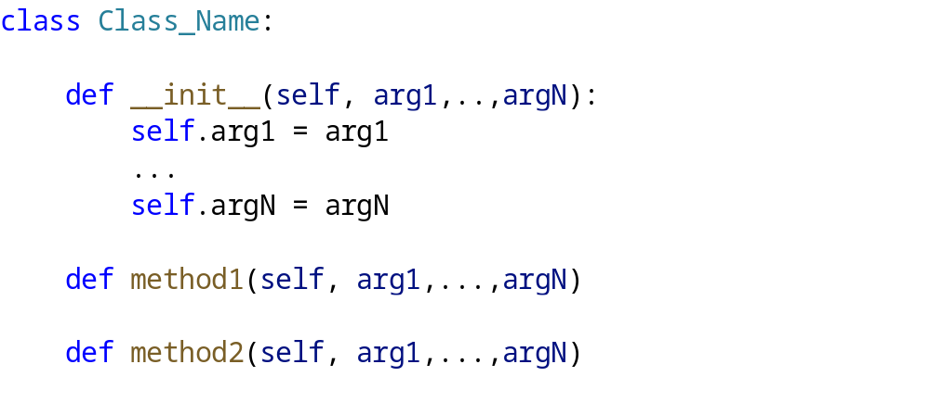
The self variable
In a class definition, the signature of __init__ method is as shown below:
We have to explicitly declare the first argument of every class method including the __init__ method as self . By convention, this argument is always named as self. (Note: self is not a keyword in Python)
The other arguments follow after the self and they are initialised by adding themselves to self using dot (.) notation in the __init__ method body.
Using self argument, you can access the attributes and methods of the class. It binds the attributes with the given arguments.
The self always refers to the current instance of the class.
In the init method, self refers to the newly created object and in other class methods, it refers to the object whose method was called.

Slide 34
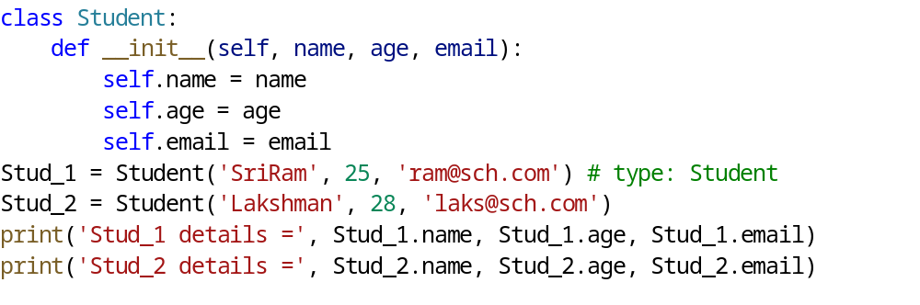
Problem: related to self variable
Write the same program again and understand that whenever an instance of the class Student is created, at the time of initialisation, self is replaced at that point by the current instance Stud_1 or Stud_2.

Slide 35
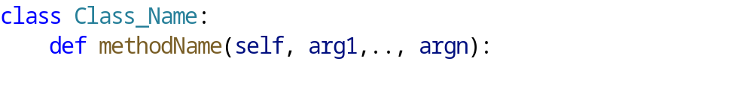

The self variable Cont…
the __init__ method uses self as the first argument. Similarly when creating any method in a class, the signature of the method contains self as the first argument.
Though the method signature uses the self , a call to the method will not use self in its calling argument list. It is to be understood that the instance before the dot(.) is replaced in place of self. So self is a placeholder for the current instance.

Slide 36
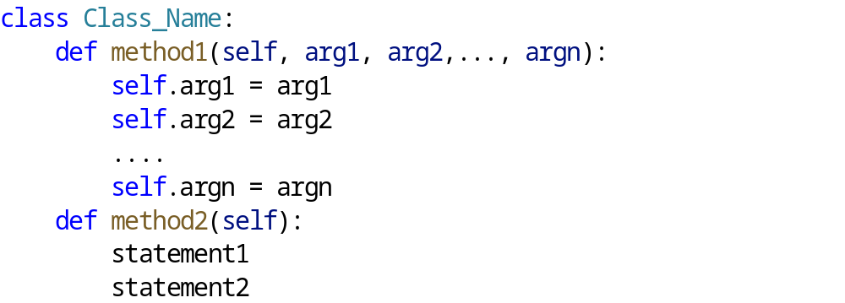
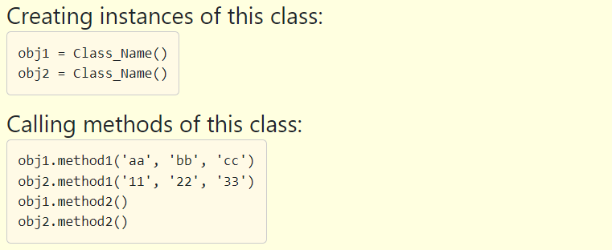
The self variable Cont… (Defining a class)

Slide 37
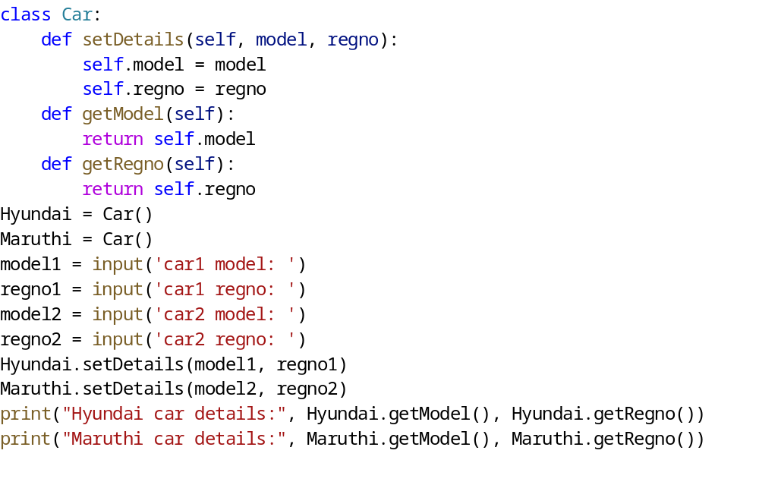
Use of self
First method sets the model and registration number
Second method returns the model
Third method returns the registration number
Set details of the car by taking the inputs from the user.
Call the methods getModel and getRegno on two instances (Hyundai and Maruthi) and print the result.

Slide 38
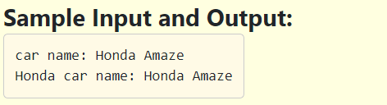
Solve this problem
Write a program that uses the self variable in class methods. Print the string passed to the method by following the below steps.Define a class Car.
Define a method setName with two arguments self, name. # def setName(self, name):
Define method by name getName with one argument self, which returns the name of the car . # def getName(self):
Create one instance of Car and name it Honda. Hint: Honda = Car()
Take name of the car from the console using input() function
Call the method setName() on Honda instance and send carname as argument.# Honda.setName('carname')
Call the method getName(), which prints the name of the car. # Honda.getName()

Slide 39
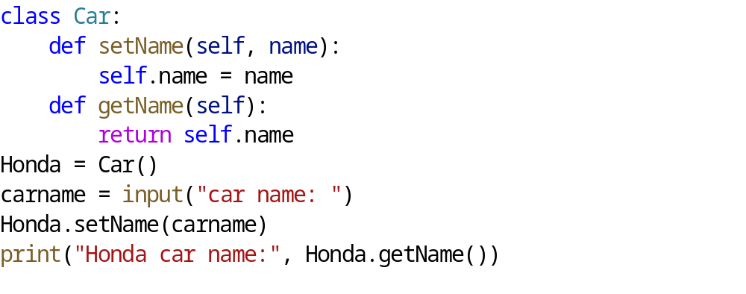
Solution

Slide 40
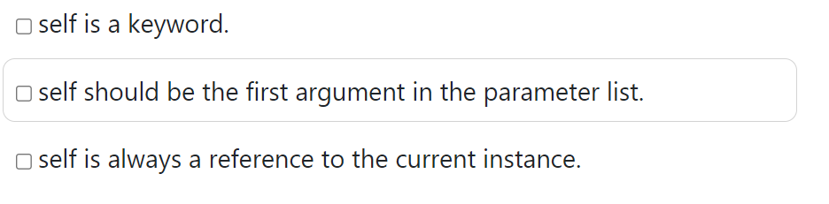
Important points related to self
When using self inside init or any method, it should be the first argument in the parameter list.
Self is a placeholder.
Self is always a reference to the current instance of the class.
Select the correct statements given below.
Select the correct option

Slide 41
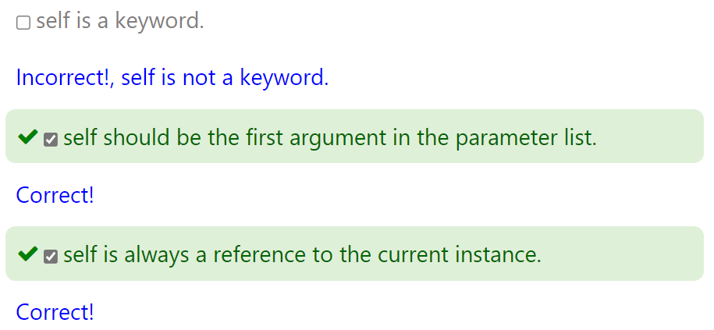
Select the correct option

Slide 42
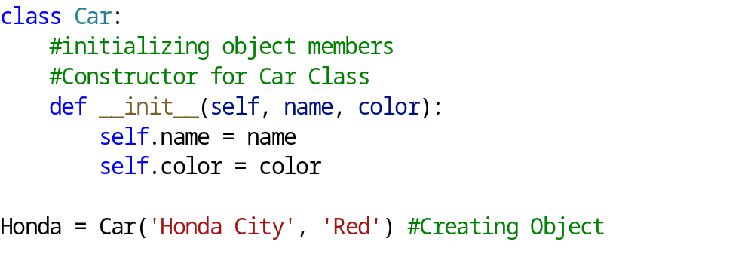
Constructors
A constructor can be viewed as a specific method used by a class to perform tasks such as initialising variables, or any startup task that needs to be done when an instance of a class (object) is created.
In Python, the constructor is defined with a single name called __init__(self) across all the classes. This method has two leading underscores and two trailing underscores, a convention that helps prevent Python’s default method names from conflicting with user defined method names.

Slide 43
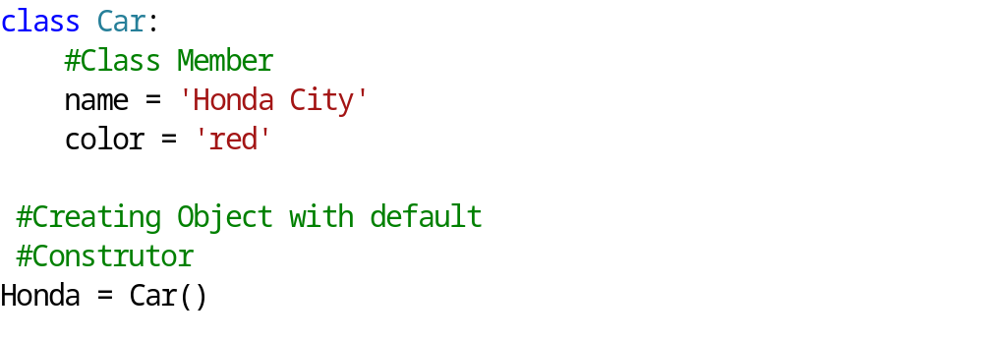
Constructors
When we create a class without a constructor, Python automatically creates a default constructor that doesn’t do anything but instantiates the object.
Constructors in Python can be overloaded based on the number of arguments.
Based on the number of arguments, the specific constructor on the class is invoked when an instance is created.

Slide 44
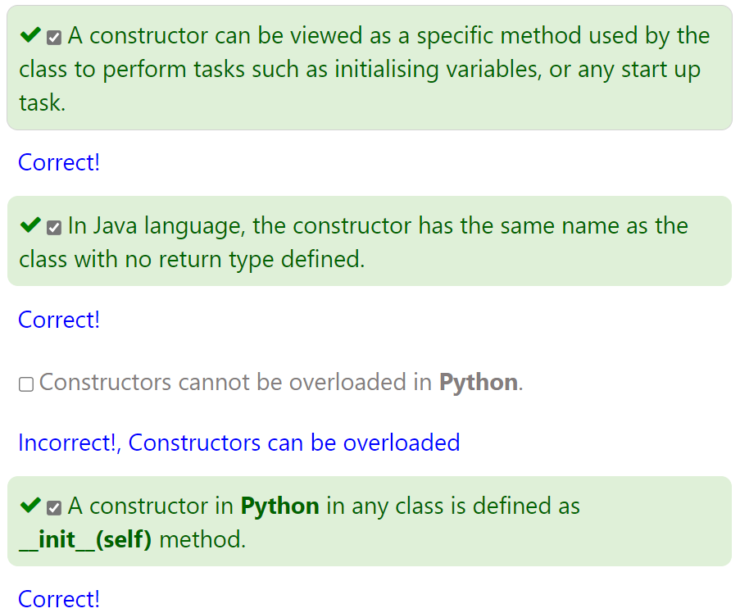
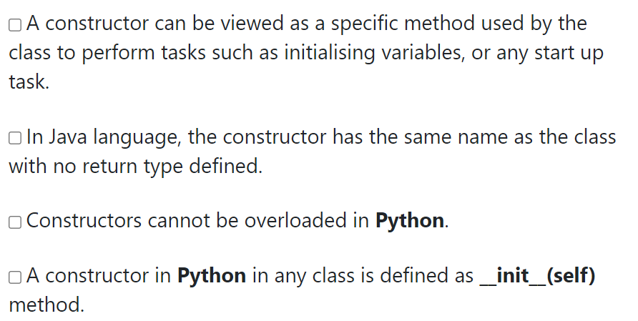
Select the correct option

Slide 45
Write a simple program
Define a class Student
Define __init__ method with arguments self, name, age and email.
Inside the __init__ method, set self.name = name, self.age = age, self.email = email.
Take name and age from the console by calling input and store them in the variables s1_name, s1_age
# s1_name= input("Please enter a name of the student1: ")
# s1_age = int(input("Please enter age of the student1: "))
Create an instance Stud_1 of class Student by passing the values as arguments
# Stud_1 = Student(s1_name, s1_age, "arya@gmail.com")
Take name and age from the console by calling input and store them in the variables s2_name, s2_age
# s2_name= input("Please enter a name of the student2:")
# s2_age = int(input("Please enter age of the student2:"))
Create an instance Stud_2 of class Student by passing the values as arguments
# Stud_2 = Student(s2_name, s2_age , "geetha@gmail.com")
Print Stud_1.name
# print ('Stud_1.name = ', Stud_1.name)
Print Stud_2.name
#print ('Stud_2.name = ', Stud_2.name)

Slide 46
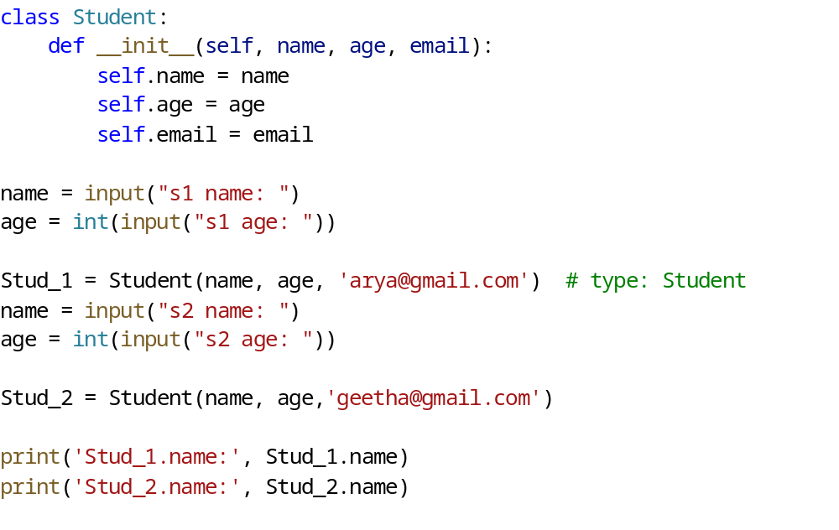
Solution to Previous Problem

Slide 47
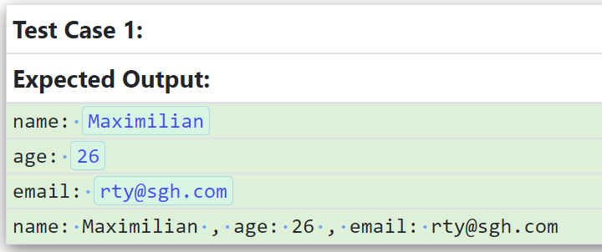
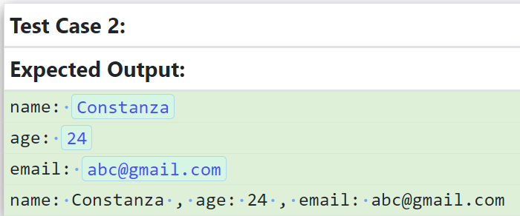
Problem
Write a program to print the details of the student as shown in the sample test cases. Take the input from the user for name, age and email.
Inside the __init__ method body, initialise the arguments with self. (Hint: self.name = name)
Write a statement to print the student details inside the method studentDetails.
Create an instance from the class Student.
Call the method studentDetails to print the output.

Slide 48
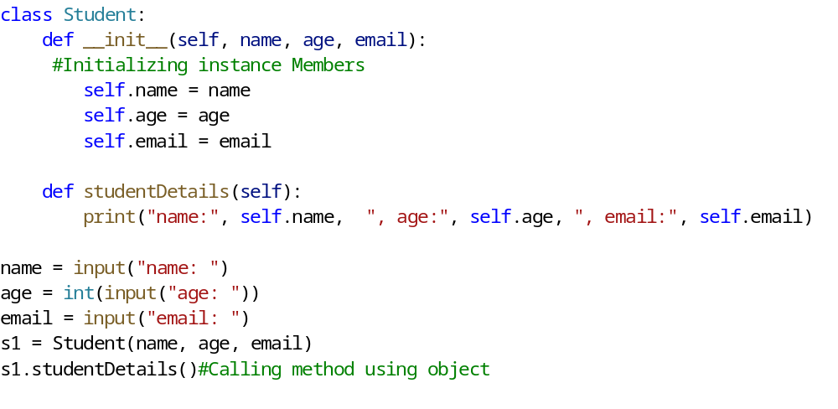
Solution to Previous Problem

Slide 49
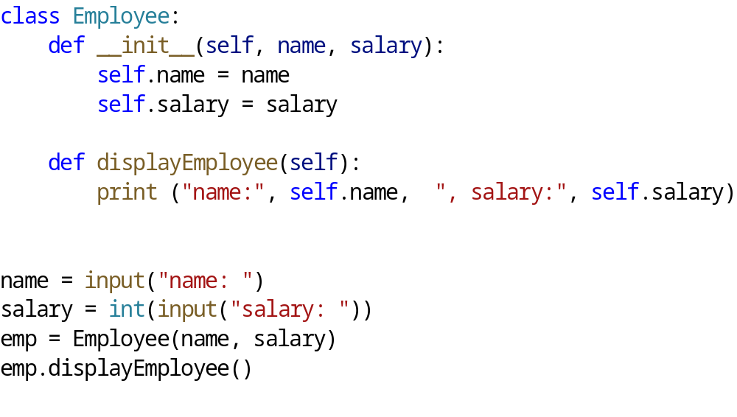
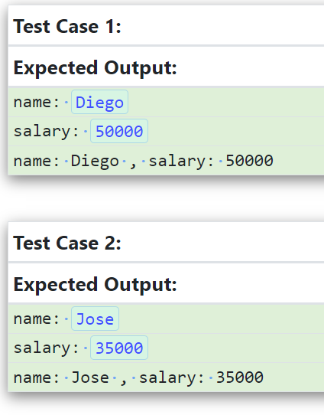
Problem
Write a program to take the name and salary as input from the user and print the details of the employee as shown in the sample test cases.

Slide 50
Methods
Methods are a set of statements that are called to perform a specific task.
What is the difference between function and method?
The terms function and method are used interchangeably, but if a specific difference is to be noted, a function does not need to be part of a class (this is followed in functional programming) whereas a method (which is a part of Object-oriented Programming) is a function which is always used inside a class to access the variables that hold instance data. So going forward, we shall be using the term method.

Slide 51
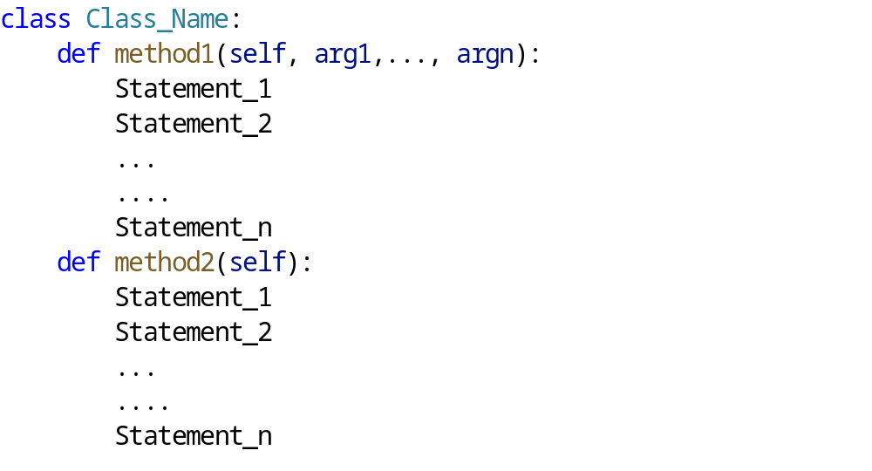
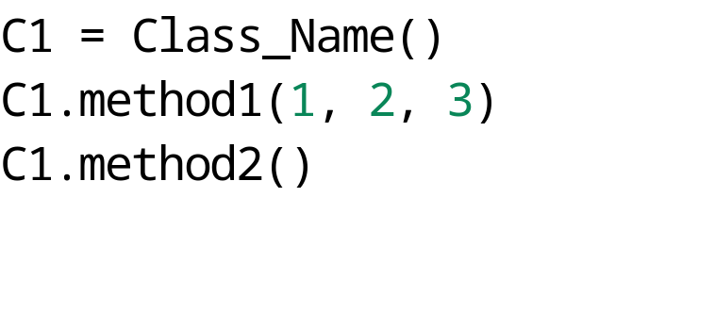
Defining Methods inside class
Methods when called, are generally specific to an instance of the class like the one below:
Points need to be remember:
Methods cannot be overloaded but can be overridden under inheritance. We shall understand about it in the next section.

Slide 52
Write a Program on the statements given below:
Define a class Person.
Add a method setName() which takes self and name as parameters.
Inside the method, set self.name = name.
Add a method getName() which takes self as parameter.
Inside the method return self.name.
Create two instances p1 and p2 of the class Person.
Call the method setName() on p1 and pass name as parameter .
Call the method setName() on p2 and pass name as parameter.
Call the method getName() on p1 and print the result.
Call the method getName() on p2 and print the result.

Slide 53
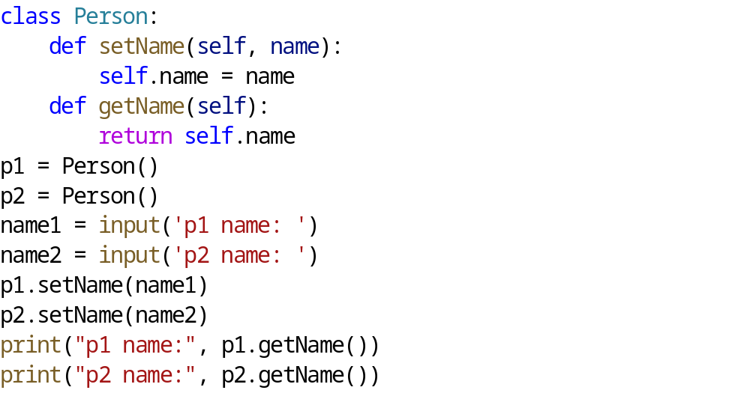
Solution

Slide 54
Implementing Method Overloading
Method overloading means the ability to have multiple methods with same name which vary in their parameters. It is one of the concepts in Polymorphism. But Python does not allow this kind of overloading i.e., multiple methods with same name is not possible.
In Python, we can create a method that can be called in different ways. In a single method, we specify the total number of parameters and depending on the method definition, we can call it with zero, one or more arguments.
The body of the method contains the logic of what needs to be done in case any parameter of the method is absent. This process of calling the same method in different ways is called method overloading.

Slide 55
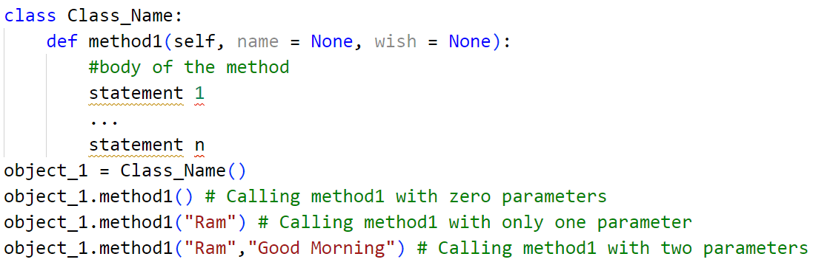
Implementing Method Overloading

Slide 56
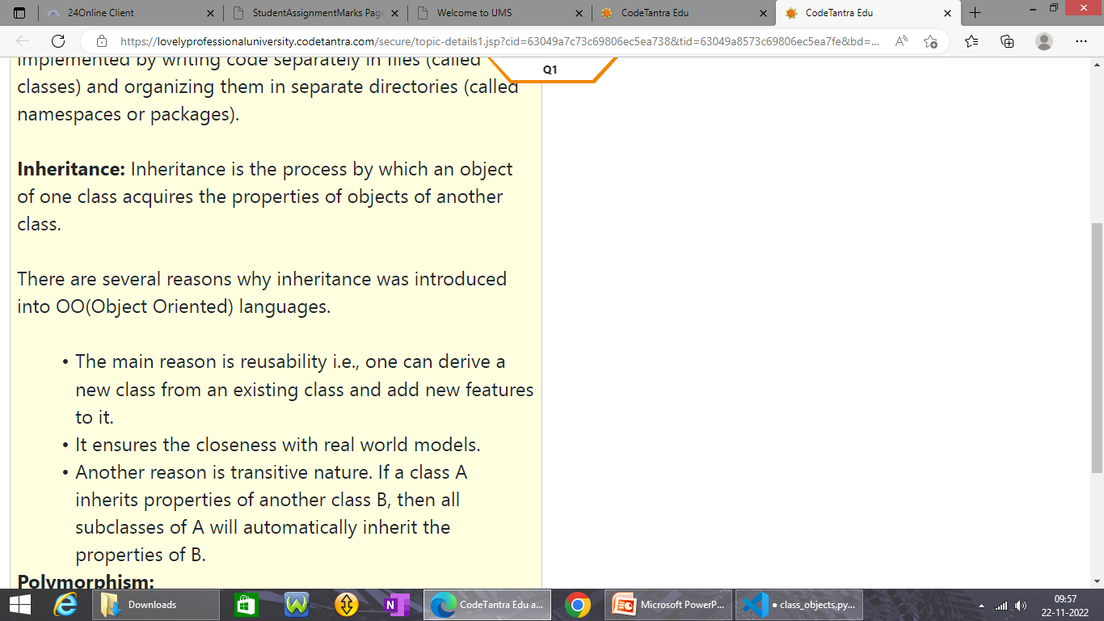
Inheritance

Slide 57
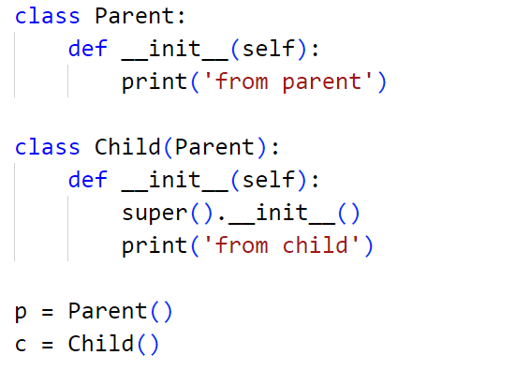
How to Inherit

Slide 58
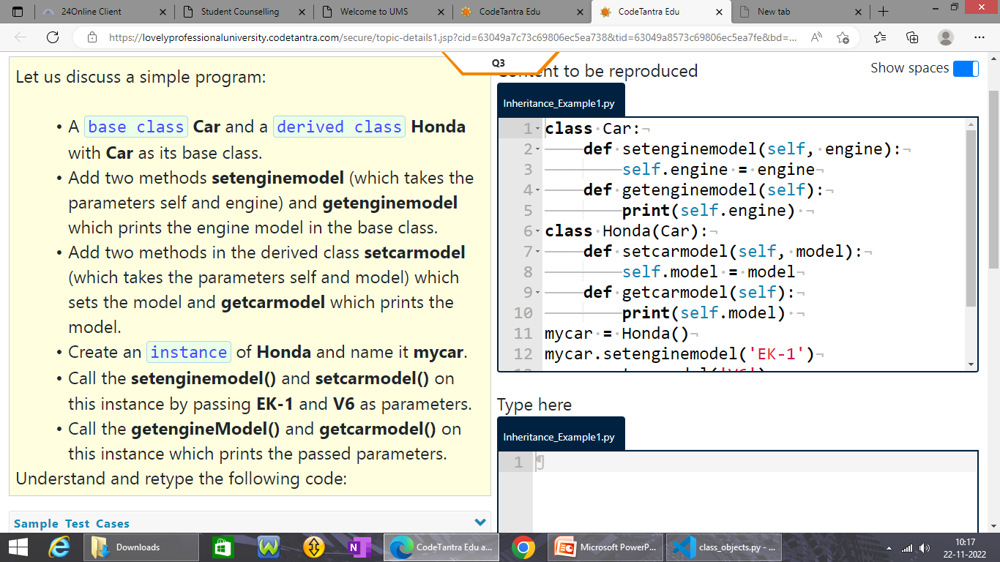
How to Inherit

Slide 59
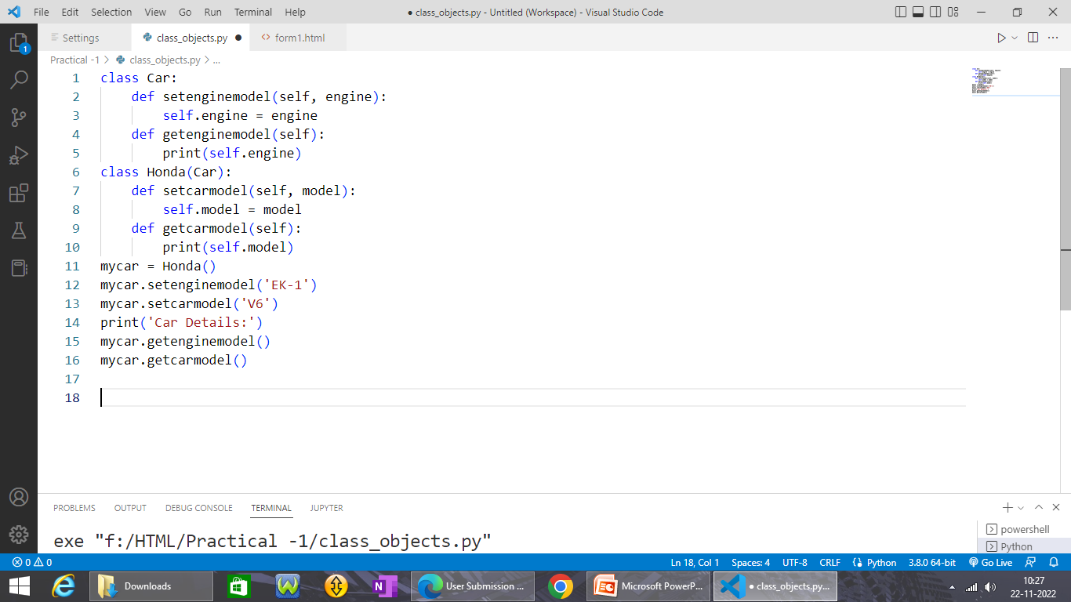
Solution to previous question

Slide 60
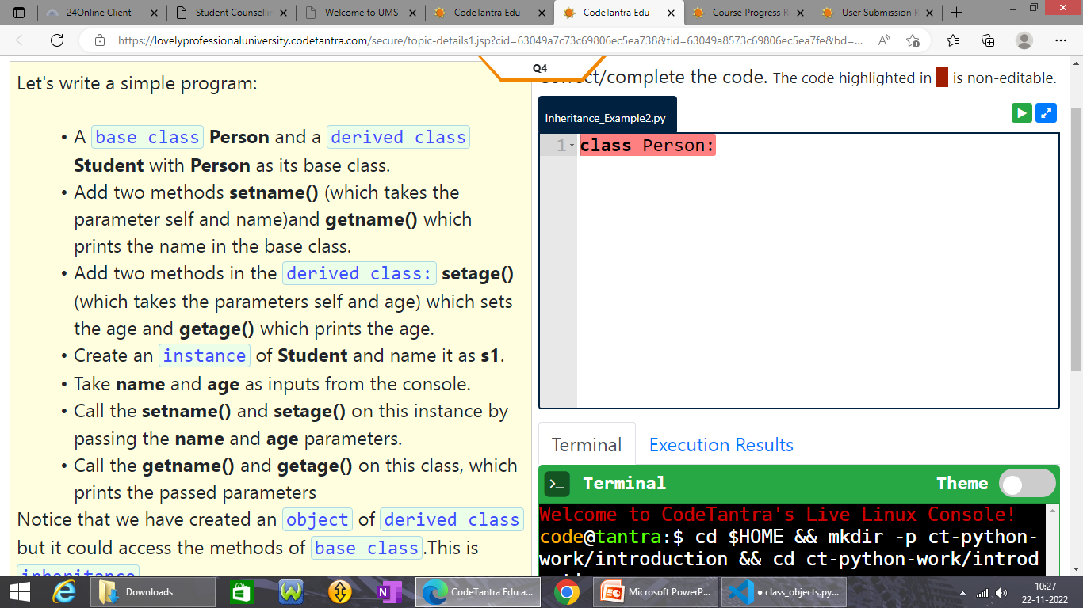
How to Inherit

Slide 61
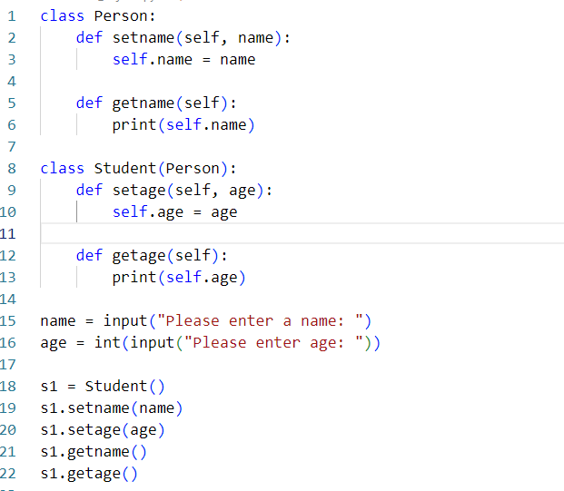
Solution to previous question

Slide 62
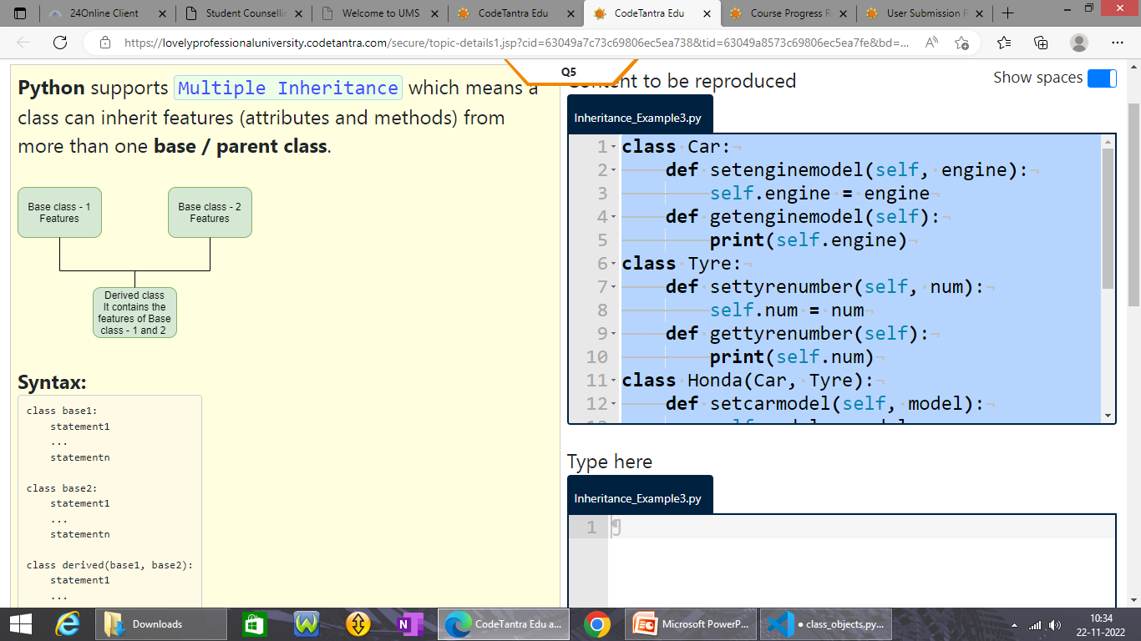
Multiple Inheritance

Slide 63
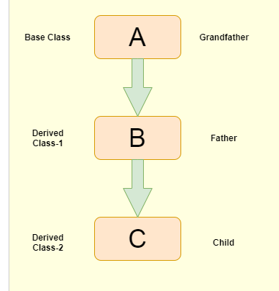
Multilevel Inheritance
Multilevel Inheritance is also possible in Python.
Multilevel Inheritance: It is a mechanism through which features of the base class and the derived class are inherited into a new derived class. It is like the grandparent-parent-child relationship. This kind of inheritance can go upto any level.
If a method is called on an instance of the derived class, it first tries to find it in the same class and if it is not available, it travels one step up and so on and so forth until it finds the method. This search can travel upto the parent / base class which is the topmost in the hierarchy.

Slide 64

Multiple and Multilevel Inheritance

Slide 65
Multiple inheritance-Example
class Car:
def setenginemodel(self, engine):
self.engine = engine
def getenginemodel(self):
print(self.engine)
class Tyre:
def settyrenumber(self, num):
self.num = num
def gettyrenumber(self):
print(self.num)
class Honda(Car, Tyre):
def setcarmodel(self, model):
self.model = model
def getcarmodel(self):
print(self.model)
accord = Honda()
accord.setenginemodel('EK-1')
accord.setcarmodel('V6')
accord.settyrenumber(236)
print('Car Details: ')
accord.getenginemodel()
accord.getcarmodel()
accord.gettyrenumber()

Slide 66
Multilevel inheritance
class Person:
def setname(self, name):
self.name = name
def getname(self):
print(self.name)
class Student(Person):
def setage(self, age):
self.age = age
def getage(self):
print(self.age)
class Address(Student):
def setaddress(self, address):
self.address = address
def getaddress(self):
print(self.address)
s1 = Address()
s1.setname('SriRam')
s1.setage('19')
s1.setaddress('Hyderabad')
s1.getname()
s1.getage()
s1.getaddress()

Slide 67


Slide 68
Which of the following is the correct option?
1. Method overloading is a feature that allows methods with multiple parameters.
2. Method overriding is a feature where we modify a behavior of a method in the derived class that is already present in the base class.
3. This overriding feature happens only when we have a base class and derived class.
1 only
2 only
2 and 3
All are correct

Slide 69
Which of the following is the correct option?
1. Method overloading is a feature that allows methods with multiple parameters.
2. Method overriding is a feature where we modify a behavior of a method in the derived class that is already present in the base class.
3. This overriding feature happens only when we have a base class and derived class.
1 only
2 only
2 and 3
All are correct

Slide 70


Slide 71
class Car:
def setbrandname(self, brandname):
self.brandname = brandname
def getbrandname(self):
print(self.brandname)
def setmodel(self, model):
self.model = model
def getmodel(self):
print(self.model)
class Accord(Car):
def setbrandname(self, brandname):
self.brandname = brandname
def getbrandname(self):
print(self.brandname)
obj = Accord()
brandname = input('brand: ')
modelname = input('model: ')
obj.setbrandname(brandname)
obj.setmodel(modelname)
obj.getbrandname()
obj.getmodel()

Slide 72


Slide 73


Slide 74


Slide 75
class Student:
__group = "ECE"
__report = "fail"
def __init__(self, name, age):
self.name = name
self.age = age
def setDetails(self, group, report):
self.__group = group
self.__report = report
def getdetails(self):
print(self.name, self.age, self.__group, self.__report)
print("Student Report Card")
s1 = Student('SriRam', '19')
s1.setDetails("CSC", "pass")
s1.getdetails()

Slide 76


Slide 77
# write your code here
class Student:
name = ""
age = ""
group = ""
report = ""
def setDetails(self):
self.name = input("name: ")
self.age = int(input("age: "))
self.group=input("group: ")
self.report = input("report: ")
def showDetails(self):
print(self.name, self.age, self.group, self.report)
s1 = Student()
s1.setDetails()
s1.showDetails()

Slide 78



Slide 79
class Student:
__name = "SriRam"
__age = "19"
__group = "ECE"
__report = "fail"
def __setdetails(self, __group, __report):
self.__group = __group
self.__report = __report
def setgroup(self, group, report):
__group = group
__report = report
self.__setdetails(__group, __report)
def getdetails(self):
print(self.__name, self.__age, self.__group, self.__report)
s1 = Student()
s1.setgroup("CSC", "pass")
s1.getdetails()

Slide 80


Slide 81
class Car:
__engineno = "EK1"
__modelno = "VX6"
def setcarinfo(self, engineno, modelno):
self.__engineno = engineno
self.__modelno = modelno
def getcarinfo(self):
print(self.__engineno, self.__modelno, self.color, self.year)
hondacity = Car()
engnumber = input("engine number: ")
hondacity.setcarinfo(engnumber, "SX6")
hondacity.color = "Blue"
hondacity.year = "2018"
hondacity.getcarinfo()

